Slide 1
Preliminary Exam Presentation
Scalable Multi-Period Optimal Power Flow for Active Distribution Systems
Aryan Ritwajeet Jha
Pursuing PhD (ECE) Power Systems

Slide 2
Introduction and Motivation
What leads to MPOPF problem?
What’s MPOPF problem?
How to tackle it?
Intended Contributions of this PhD

Slide 3
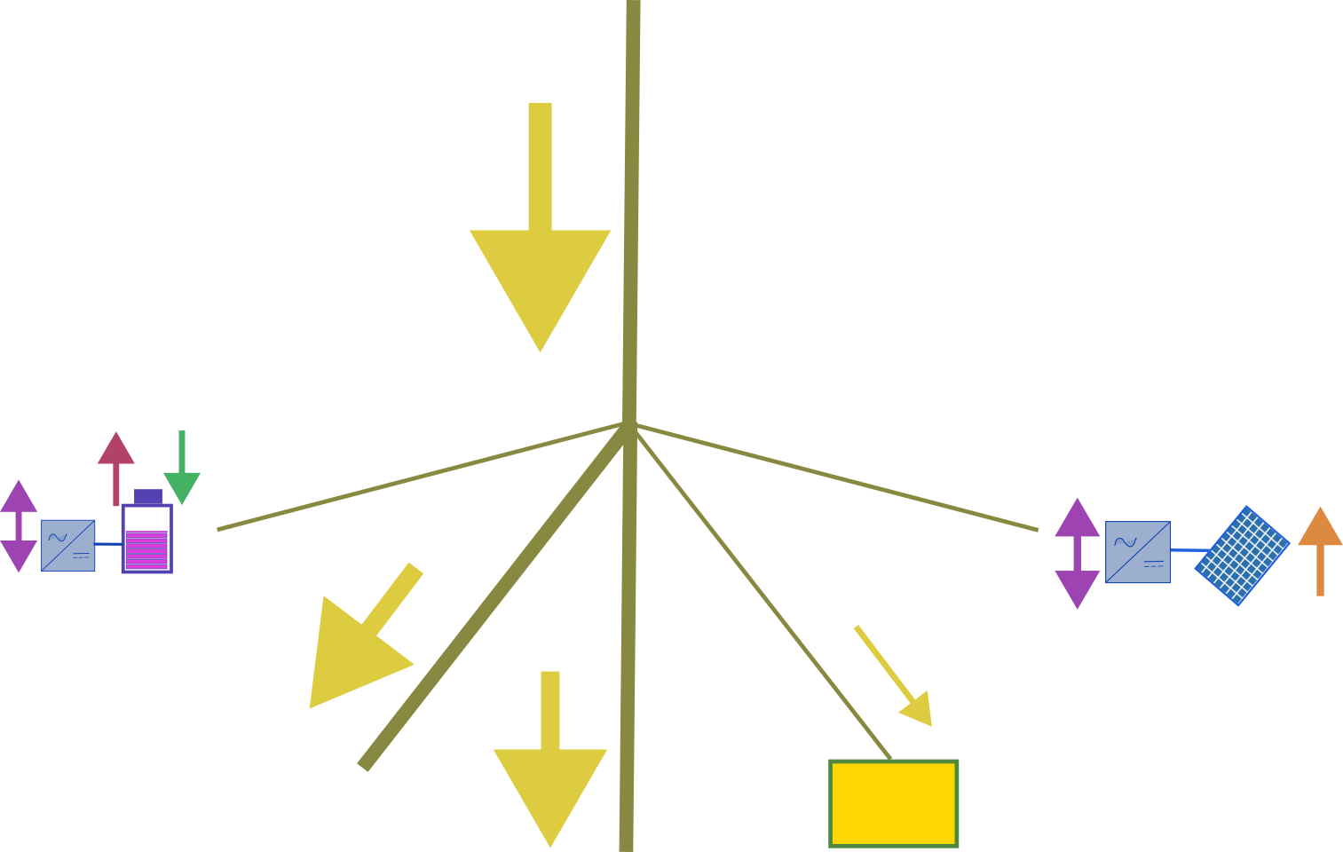

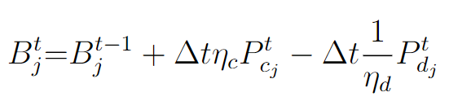
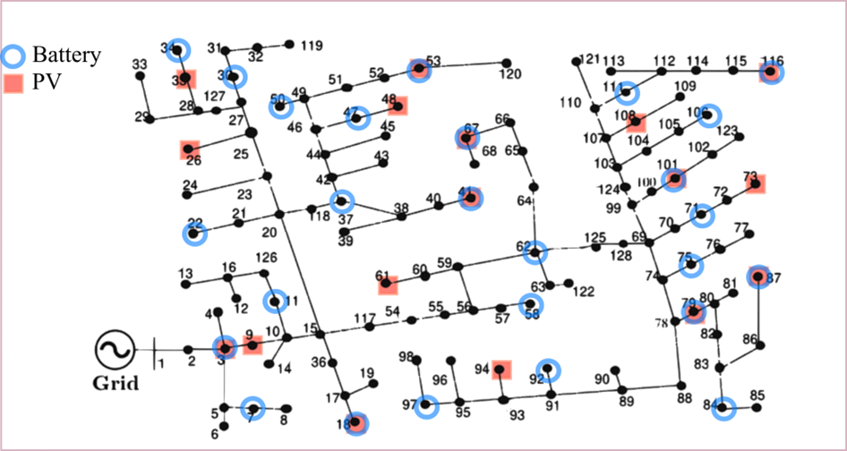
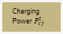
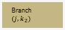

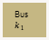
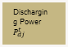
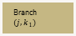

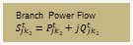
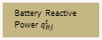
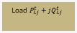
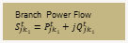

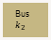
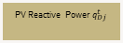
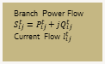
Introduction and Motivation
What introduces the Multi-Period Optimal Power Flow (MPOPF)? Problem?
The distribution grid is changing due to rising penetration of Grid-Edge Devices (GEDs) such as PVs and Batteries
Eg. EVs, On-grid storage, flexible buildings
These battery devices introduce inter-temporal behaviour – their actions at one time affect future states
This creates temporal coupling constraints
As a result, traditional OPF (single-period) is no longer sufficient
The problem becomes Multi-Period OPF (MPOPF)
MPOPF problems are much larger (size scales with #devices x time-horizon)
Leading to computational bottlenecks
Bus $i$:$v_{i}^{t}={\left(V_{i}^{t}\right)}^{2}$
Branch Power Flow $S_{ij}^{t}=P_{ij}^{t}+jQ_{ij}^{t}$
Current Flow $l_{ij}^{t}$
Branch $(i, j)$
Discharging Power $P_{dj}^{t}$
Charging Power $P_{cj}^{t}$
Bus $j$:$v_{j}^{t}={\left(V_{j}^{t}\right)}^{2}$
Battery Reactive Power $q_{Bj}^{t}$
PV Real Power $P_{Dj}^{t}$
Branch $(j, k_{1})$
Branch $(j, k_{2})$
PV Reactive Power $q_{Dj}^{t}$
Bus $k_{1}$
Branch Power Flow $S_{jk_{1}}^{t}=P_{jk_{1}}^{t}+jQ_{jk_{1}}^{t}$
Bus $k_{2}$
Load $P_{Lj}^{t}+jQ_{Lj}^{t}$
Branch Power Flow $S_{jk_{2}}^{t}=P_{jk_{2}}^{t}+jQ_{jk_{2}}^{t}$

Slide 4





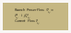
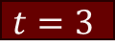
Introduction and Motivation
Branch Power Flow $S_{ij}^{t}=P_{ij}^{t}+jQ_{ij}^{t}$
Current Flow $l_{ij}^{t}$
Bus $i$:$v_{i}^{t}={\left(V_{i}^{t}\right)}^{2}$
Branch $(i, j)$
Discharging Power $P_{dj}^{t}$
Charging Power $P_{cj}^{t}$
Bus $j$:$v_{j}^{t}={\left(V_{j}^{t}\right)}^{2}$
PV Real Power $P_{Dj}^{t}$
Battery Reactive Power $q_{Bj}^{t}$
Branch $(j, k_{1})$
Branch $(j, k_{2})$
PV Reactive Power $q_{Dj}^{t}$
MPOPF Problem Visual
Bus $k_{1}$
Branch Power Flow $S_{jk_{1}}^{t}=P_{jk_{1}}^{t}+jQ_{jk_{1}}^{t}$
Bus $k_{2}$
Load $P_{Lj}^{t}+jQ_{Lj}^{t}$
Branch Power Flow $S_{jk_{2}}^{t}=P_{jk_{2}}^{t}+jQ_{jk_{2}}^{t}$
$$t=1$$
$$t=2$$
$$t=3$$
Intertemporal Constraints
Intertemporal Constraints
Intertemporal Constraints
Set Points
Set Points
Set Points
Rectangle sizes representative of size of each Optimization Problem
For nonlinear optimization problems, computational burden increases superlinearly with size!

Slide 5
Introduction and Motivation
Why Decomposition Approach?
Previously techniques like Successive Linearization [usmain] or Two-stage hierarchical optimization [Nawaf2018] have been employed for MPOPF which can miss global optimum
Realistic modelling often requires nonlinear distribution system representations
But these are computationally expensive
Decomposition-based algorithms can break MPOPF into smaller, parallelizable subproblems
This enables:
Scalability to larger feeders and larger timescales
Faster or near real-time solutions
Adoption by DSOs when GED coordination becomes operationally necessary
Accurate modelling + Scalable Decomposition is the key to enabling future grid operations

Slide 6
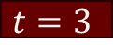


Introduction and Motivation
Branch Power Flow $S_{ij}^{t}=P_{ij}^{t}+jQ_{ij}^{t}$
Current Flow $l_{ij}^{t}$
Bus $i$:$v_{i}^{t}={\left(V_{i}^{t}\right)}^{2}$
Branch $(i, j)$
Discharging Power $P_{dj}^{t}$
Charging Power $P_{cj}^{t}$
Bus $j$:$v_{j}^{t}={\left(V_{j}^{t}\right)}^{2}$
PV Real Power $P_{Dj}^{t}$
Battery Reactive Power $q_{Bj}^{t}$
Branch $(j, k_{1})$
Branch $(j, k_{2})$
PV Reactive Power $q_{Dj}^{t}$
Why Decomposition Approach? Visual
Bus $k_{1}$
Branch Power Flow $S_{jk_{1}}^{t}=P_{jk_{1}}^{t}+jQ_{jk_{1}}^{t}$
Bus $k_{2}$
Load $P_{Lj}^{t}+jQ_{Lj}^{t}$
Branch Power Flow $S_{jk_{2}}^{t}=P_{jk_{2}}^{t}+jQ_{jk_{2}}^{t}$
$$t=1$$
$$t=2$$
$$t=3$$
Intertemporal Constraints
Intertemporal Constraints
Intertemporal Constraints
Set Points
Set Points
Set Points
$$t=1$$
$$t=2$$
$$t=3$$
Intertemporal Constraints
Intertemporal Constraints
Intertemporal Constraints
Set Points
Set Points
Set Points
Rectangle sizes representative of size of each Optimization Problem
For nonlinear optimization problems, computational burden increases superlinearly with size!

Slide 7
Introduction and Motivation
Intended Contributions of my PhD
A framework for solving the MPOPF problem…
Which has a systematic procedure to model components of power distribution system in a manner faithful to their behaviour yet computationally efficient to solve for
That employs tailored decomposition algorithms which can exploit model’s properties to come up with an even faster solution
Which has provision for comparison of output solution with those of trusted softwares, say OpenDSS
Whose procedure may be theoretically justified
An example of

Slide 8
Contents
Foundational Studies
Modelling Tradeoff Analysis
Spatial Decomposition Algorithm
Temporal Decomposition Algorithms – tADMM and DDP
Future Works

Slide 9
Decomposition Algorithms Implemented
MPDOPF - Spatial Decomposition Algorithm
tADMM - Temporal Decomposition Algorithm
DDP - Temporal Decomposition Algorithm
Future Works

Slide 10
Modelling Tradeoff Analysis – Linear vs Nonlinear

Slide 11
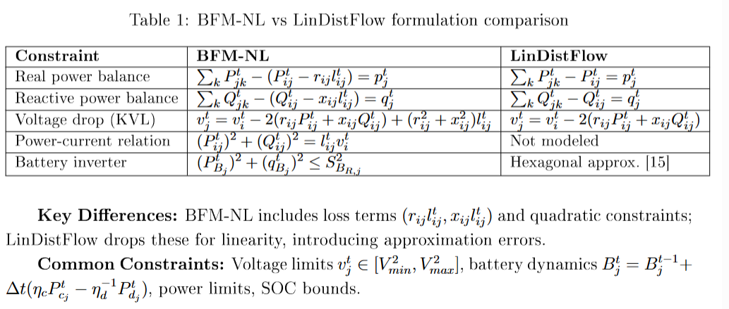
Modelling Tradeoff Analysis – Linear vs Nonlinear
Key Formulation Differences
Add slides for BFM-NL vs LinDistFlow

Slide 12
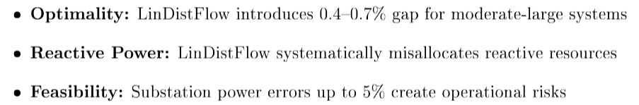
Modelling Tradeoff Analysis – Linear vs Nonlinear
Key Results at a Glance
Add slides for BFM-NL vs LinDistFlow

Slide 13
MPDOPF - Spatial Decomposition of the MPOPF problem using ENApp
Intuition for Algorithm
Simulation and Results

Slide 14
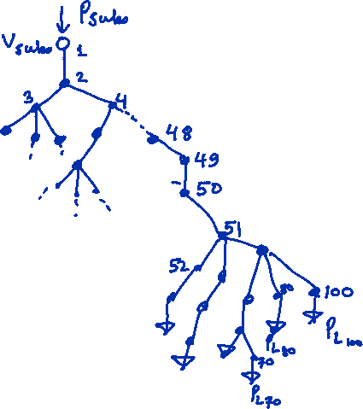
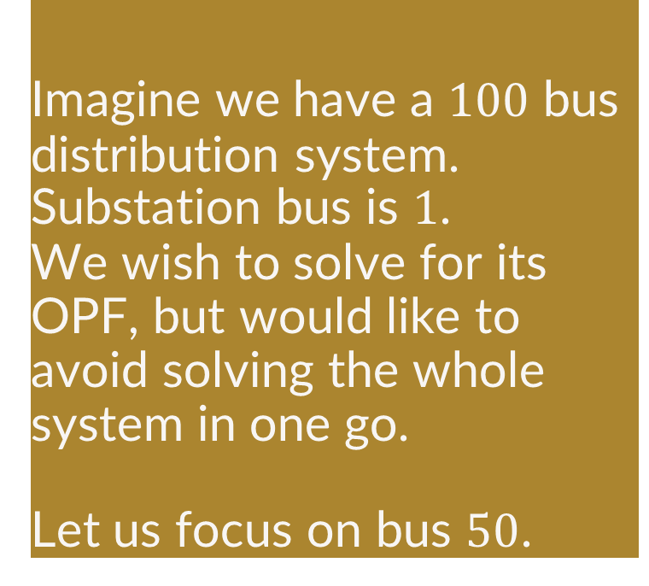
MPDOPF - Spatially Decomposition MPOPF
Intuition for Spatial Decomposition
Imagine we have a $100$ bus distribution system. Substation bus is $1$.
We wish to solve for its OPF, but would like to avoid solving the whole system in one go.
Let us focus on bus $50$.
Source for Algorithm for OPF: ENApp [1]

Slide 15
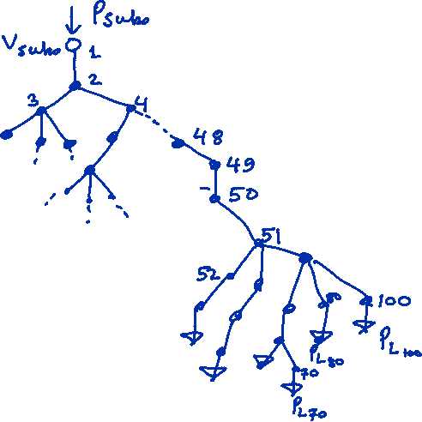
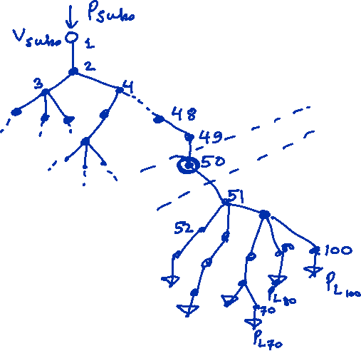
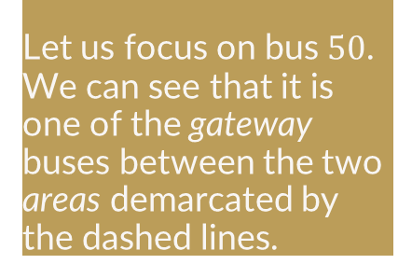
MPDOPF - Spatially Decomposition MPOPF
Intuition for Spatial Decomposition
Let us focus on bus $50$.
We can see that it is one of the gateway buses between the two areas demarcated by the dashed lines.

Slide 16
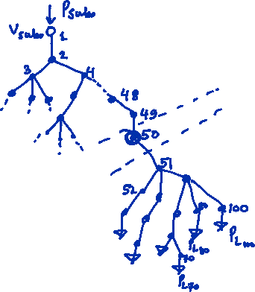
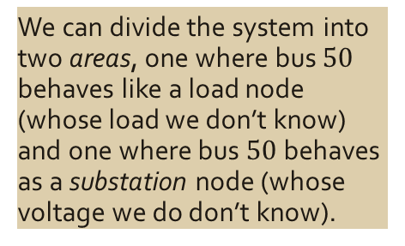
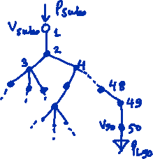
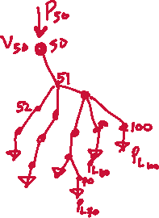
MPDOPF - Spatially Decomposition MPOPF
Intuition for Spatial Decomposition
We can divide the system into two areas, one where bus $50$ behaves like a load node (whose load we don’t know) and one where bus $50$ behaves as a substation node (whose voltage we do don’t know).
Now we have two OPF problems, each of half the size (and less than half the computation time) of the original problem

Slide 17


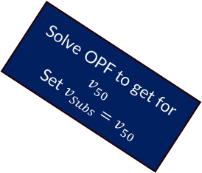
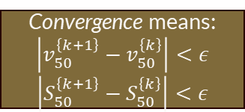
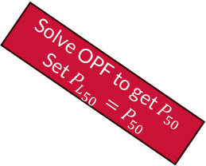
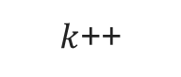



MPDOPF - Spatially Decomposition MPOPF
Intuition for Spatial Decomposition via OPF (single period)
Start
Each macro-iteration ($k)$:
$k$++
Area $1$
Convergence means:
$$\left|v_{50}^{\left\{k+1\right\}}−v_{50}^{\left\{k\right\}}\right|<ε$$
$$\left|S_{50}^{\left\{k+1\right\}}−S_{50}^{\left\{k\right\}}\right|<ε$$
Solve OPF to get $P_{50}$
Set ${P_{L}}_{50}=P_{50}$
Exchange boundary variables, and continue.
Area $2$
Solve OPF to get for $v_{50}$
Set $v_{Subs}=v_{50}$
No
Yes
Are boundary variables
converged?
Stop

Slide 18

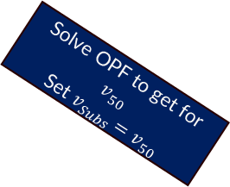


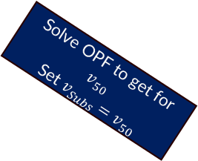
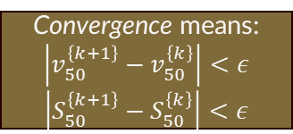
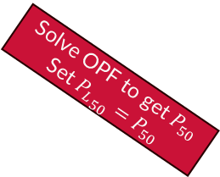



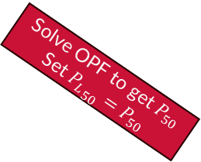
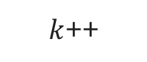
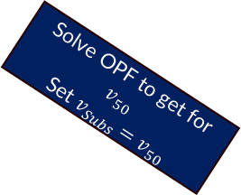







MPDOPF - Spatially Decomposition MPOPF
Convergence means:
$$\left|v_{50}^{\left\{k+1\right\}}−v_{50}^{\left\{k\right\}}\right|<ε$$
$$\left|S_{50}^{\left\{k+1\right\}}−S_{50}^{\left\{k\right\}}\right|<ε$$
Spatial Decomposition workflow for MPOPF
Start
$k$++
Each macro-iteration ($k)$:
Area $1$
$$t=1$$
Area $1$
$$t=2$$
Area $1$
$$t=3$$
Solve OPF to get $P_{50}$
Set ${P_{L}}_{50}=P_{50}$
Solve OPF to get $P_{50}$
Set ${P_{L}}_{50}=P_{50}$
Solve OPF to get $P_{50}$
Set ${P_{L}}_{50}=P_{50}$
Exchange boundary variables, and continue.
Area $2$
Area $2$
Area $2$
Solve OPF to get for $v_{50}$
Set $v_{Subs}=v_{50}$
Solve OPF to get for $v_{50}$
Set $v_{Subs}=v_{50}$
Solve OPF to get for $v_{50}$
Set $v_{Subs}=v_{50}$
Are boundary variables
converged?
No
Yes
Stop

Slide 19
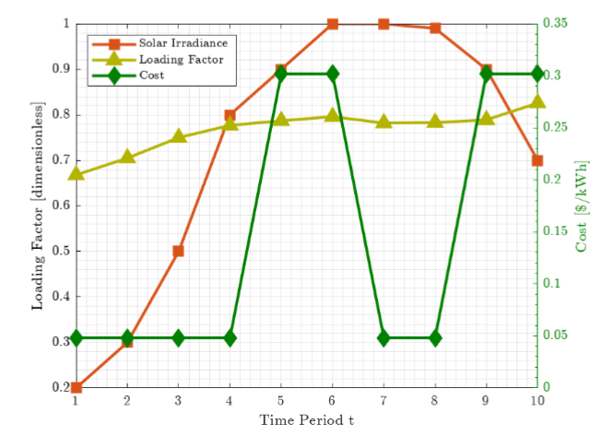
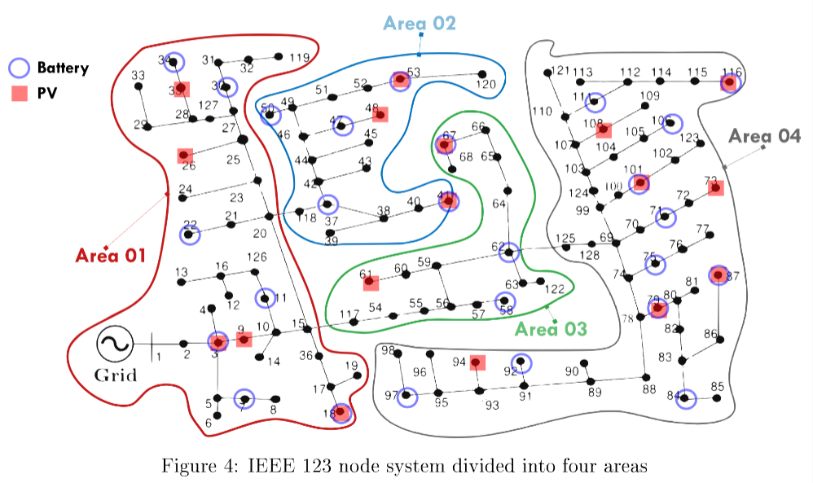
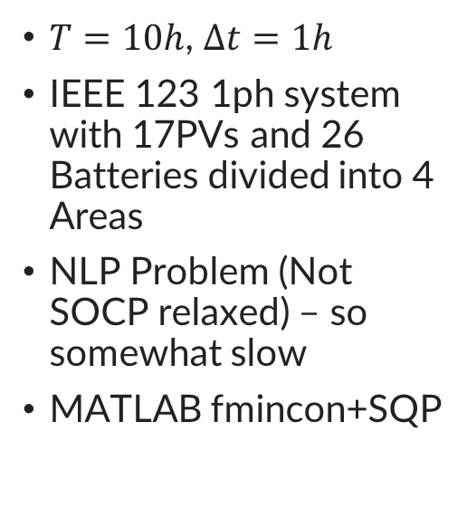
MPDOPF - Spatially Decomposition MPOPF
Key Results at a Glance – Scenario Setup
$T=10h$, $Δt=1h$
IEEE 123 1ph system with 17PVs and 26 Batteries divided into 4 Areas
NLP Problem (Not SOCP relaxed) – so somewhat slow
MATLAB fmincon+SQP

Slide 20
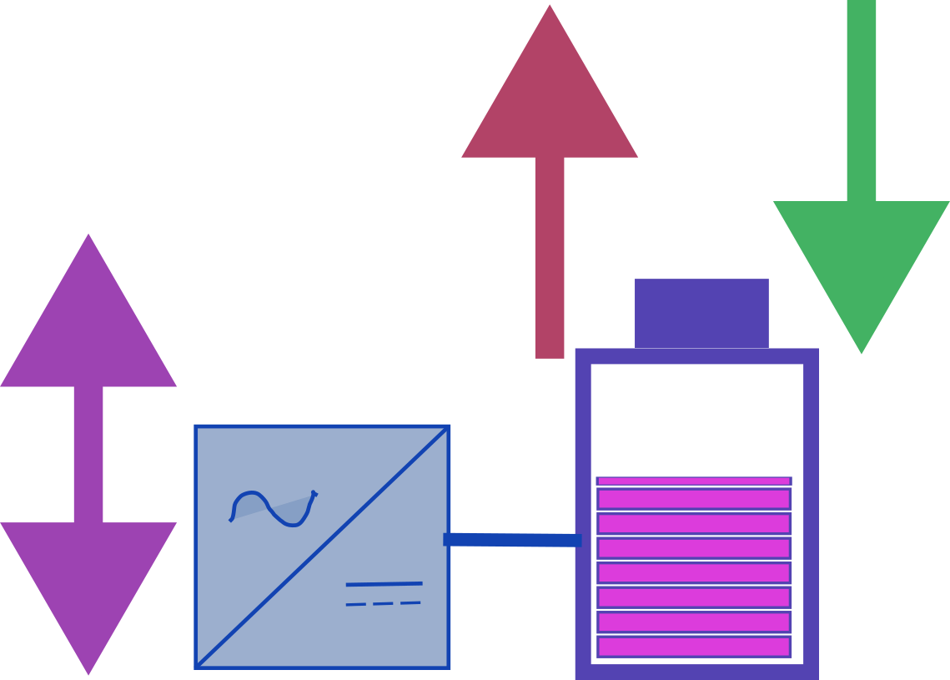

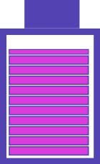
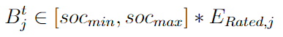
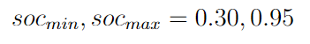
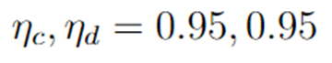
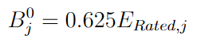
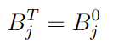








MPDOPF - Spatially Decomposition MPOPF
Key Results at a Glance – Scenario Setup (Battery Modelling)
Discharging Power $P_{dj}^{t}$
Charging Power $P_{cj}^{t}$
Battery SOC Equation
Note: Values here are typical in OPF literature [2, 3]
Reactive Power $q_{Bj}^{t}$
Battery SOC $B_{j}^{t}$
Inverter Rating ${S_{Rated}}_{j}$
$$∈($$
$$,$$
$$)$$
Battery SOC Limits
Battery SOC Limits
Battery SOC Limits
Charging/Discharging Efficiencies
Initial SOC
After full horizon:
Terminal SOC constraint

Slide 21


















MPDOPF - Spatially Decomposition MPOPF
Key Results at a Glance – Scenario Setup (Full NLP Model)
Branch Flow Model (Nonlinear) used as per [bfm01-low]
Bus $i$:$v_{i}^{t}={\left(V_{i}^{t}\right)}^{2}$
Branch Power Flow $S_{ij}^{t}=P_{ij}^{t}+jQ_{ij}^{t}$
Current Flow $l_{ij}^{t}$
Branch $(i, j)$
Discharging Power $P_{dj}^{t}$
Charging Power $P_{cj}^{t}$
Bus $j$:$v_{j}^{t}={\left(V_{j}^{t}\right)}^{2}$
PV Real Power $P_{Dj}^{t}$
Battery Reactive Power $q_{Bj}^{t}$
Branch $(j, k_{1})$
Branch $(j, k_{2})$
PV Reactive Power $q_{Dj}^{t}$
Bus $k_{1}$
Branch Power Flow $S_{jk_{1}}^{t}=P_{jk_{1}}^{t}+jQ_{jk_{1}}^{t}$
Bus $k_{2}$
Load $P_{Lj}^{t}+jQ_{Lj}^{t}$
Branch Power Flow $S_{jk_{2}}^{t}=P_{jk_{2}}^{t}+jQ_{jk_{2}}^{t}$

Slide 22


MPDOPF - Spatially Decomposition MPOPF
Key Results at a Glance – Optimality and performance for IEEE 123 1ph T=10
Smaller Problem Size
Same Converged Objective Value
Decision Variables could be different
Appreciable Computation Speedup ($10$times) !
Result: Proposed MPDOPF Method cuts down the computational complexity of the MPOPF problem, making way for faster solution!

Slide 23

MPDOPF - Spatially Decomposition MPOPF
Key Results at a Glance – ACOPF feasibility analyses for IEEE 123 1ph T=10
Feasibility tested against OpenDSS

Slide 24
tADMM – temporal ADMM
Consensus based ADMM
Formulation
Results

Slide 25




tADMM – temporal ADMM
Sources: [ADMM notes CMU], [JalalKazempourYT]
Consensus ADMM Schematic
Individual Subproblem $i$
Individual Subproblem $i$
Individual Subproblem $i$
Global Problem
Individual Subproblem $i$
Individual Subproblem $i$
Consensus ADMM Formulation
Individual Subproblem $i$
Consensus ADMM Updates

Slide 26


tADMM – temporal ADMM
Adaptation of Consensus ADMM for the MPOPF problem
Individual Subproblem $i$
Individual Subproblem $i$
Individual Subproblem $i$
Global Problem
Individual Subproblem $i$
Individual Subproblem $i$
Individual Subproblem $i$
Source: [ADMM notes CMU]

Slide 27



tADMM – temporal ADMM
Algorithm formulation for copper plate example: Update 1 Primal Update
Copper Plate = 1 Substation + 1 Battery supplying 1 Load for $T$ time-steps
Input Curves:
$$λ^{t}, C^{t} ∀t∈Τ$$

Slide 28


tADMM – temporal ADMM
Algorithm formulation for copper plate example: Update 1 Primal Update
Primal Updates x $T$
Each subproblem $t_{0}$ optimizes for its non-temporal constraints only
However the temporal constraints (SOC trajectory) is computed for all time-steps
This ensures that ADMM penalty term can compare the full trajectory $B^{t0}$ with the consensus $\hat{B}$
Uses last known values of $\hat{B}$ and $u^{t0}$ and computes $B^{t0}$

Slide 29



tADMM – temporal ADMM
Algorithm formulation for copper plate example: Update 2 Consensus Update
Consensus Update x $1$
Uses last known values of $B^{t0}$and $u^{t0}$ and computes $\hat{B}$
The consensus update computes a negotiated battery schedule $\hat{B}$ by averaging the proposed values across all time steps
Note that clamping isn’t analytically required, but is there for floating point leakage catching purposes

Slide 30



tADMM – temporal ADMM
Algorithm formulation for copper plate example: Update 3 Dual Update
Dual Update x $T$
Uses last known values of $B^{t0}$and $\hat{B}$ and computes $u^{t0}$
Dual variables $u^{t0}$ act like negotiation pressure
They get updated in a manner which penalizes disagreement of a subproblem to the global consensus in a future iteration

Slide 31



tADMM – temporal ADMM
Algorithm formulation for copper plate example: Convergence Criteria
1. Primal Residual (Consensus Violation)
Each subproblem’s own copy of SOC variables should resemble that of the global copy
2. Dual Residual (Consensus Change)
The consensus value should stabilize to a fixed point
Adaptive ADMM $(ρ)$ was utilized based on relative values of these norms

Slide 32



tADMM – temporal ADMM
MPOPF Simulation results for copper plate example
Input Curves
Battery Action plots showcase that the results (control actions for battery dispatch) are identical
All other results such as $P_{Subs}^{t}, P_{SubsCost}^{t}$ (not shown here) are also identical
Brute Forced Battery Action Plots
tADMM Battery Action Plots

Slide 33




tADMM – temporal ADMM
Update modelling formulation for Full Network Model – Test Case Description
IEEE 123 1ph System with $17$ PVs and $26$ Batteries – represented in both LinDistFlow (linear) and BFM-NL (nonlinear) models
Input Curves:
$$λ_{L}^{t}, λ_{PV}^{t}, C^{t} ∀t∈1:T, T=96, Δt=15min$$
IEEE123A_1ph Network

Slide 34


tADMM – temporal ADMM
Update modelling formulation for Full Network Model – Update 1 Primal Update
Objective Function: Cost of Borrowed Substation Power + Cost of Battery Operation + Augmented Lagrangian Term
Primal Updates x $T$
This model is for LinDistFlow, but SOCP based BFM-NL has also been implemented by making the relevant adjustments (model not shown here)
Uses last known values of $\hat{B_{j}}$ and $u_{j}^{t0}$ and computes $B_{j}^{t0} ∀ j∈B$

Slide 35

tADMM – temporal ADMM
Update modelling formulation for Full Network Model – Update 1 Primal Update
Objective Function: Cost of Borrowed Substation Power + Cost of Battery Operation + Augmented Lagrangian Term
Primal Updates x $T$
This model is for LinDistFlow, but SOCP based BFM-NL has also been implemented by making the relevant adjustments (model not shown here)
Uses last known values of $\hat{B_{j}}$ and $u_{j}^{t0}$ and computes $B_{j}^{t0} ∀ j∈B$
$t_{0}$ specific Network Constraints: Temporally Uncoupled

Slide 36

tADMM – temporal ADMM
Update modelling formulation for Full Network Model – Update 1 Primal Update
Objective Function: Cost of Borrowed Substation Power + Cost of Battery Operation + Augmented Lagrangian Term
Primal Updates x $T$
This model is for LinDistFlow, but SOCP based BFM-NL has also been implemented by making the relevant adjustments (model not shown here)
Uses last known values of $\hat{B_{j}}$ and $u_{j}^{t0}$ and computes $B_{j}^{t0} ∀ j∈B$
$t_{0}$ specific Network Constraints: Temporally Uncoupled
Shared Temporally Coupled Constraints

Slide 37

tADMM – temporal ADMM
Update modelling formulation for Full Network Model – Update 1 Primal Update
Objective Function: Cost of Borrowed Substation Power + Cost of Battery Operation + Augmented Lagrangian Term
Primal Updates x $T$
This model is for LinDistFlow, but SOCP based BFM-NL has also been implemented by making the relevant adjustments (model not shown here)
Uses last known values of $\hat{B_{j}}$ and $u_{j}^{t0}$ and computes $B_{j}^{t0} ∀ j∈B$
This is an initial formulation where the entire SOC trajectory is included in the augmented Lagrangian and consensus updates
Although this introduces additional shared linear variables, their impact on computational complexity is small compared to the nonlinear OPF components
This is a conservative starting point; ongoing work will reduce the number of shared variables to improve scalability
Shared Temporally Coupled Constraints

Slide 38



tADMM – temporal ADMM
Update modelling formulation for Full Network Model – Updates 2 and 3
Consensus Updates x $n_{B}$
Uses last known values of $B_{j}^{t0}$and $u_{j}^{t0}$ and computes $\hat{B_{j}}$ $∀ j∈B$
Dual Updates x $n_{B}$
Uses last known values of $B_{j}^{t0}$and $\hat{B_{j}}$and computes $u_{j}^{t0} ∀ j∈B$
Both updates are pretty much the same as that for copper plate example, only differing in having to account for multiple batteries

Slide 39



tADMM – temporal ADMM
MPOPF Simulation results for IEEE123A_1ph – Battery Actions
These results are for nonlinear model (SOCP relaxed BFM-NL)
Battery Action plots showcase that the results (control actions for battery dispatch) are identical
Input Curves
Brute Forced Battery Action Plots
tADMM Battery Action Plots

Slide 40



tADMM – temporal ADMM
MPOPF Simulation results for IEEE123A_1ph – PV Actions
PV Reactive Power Dispatch plots showcase are generally NOT necessarily identical
Input Curves
Note that PV real power dispatch is a fixed variable dependent only on $λ_{PV}^{t}$ (fixed variable)
Brute Forced PV Action Plots
tADMM PV Action Plots

Slide 41


tADMM – temporal ADMM
MPOPF Simulation results for IEEE123A_1ph – Convergence
Convergence of Objective Function:
tADMM (Blue) vs Brute Forced (Orange)
Convergence of norms:
r-norm (Green) vs s-norm (Orange)
--- tADMM SUBPROBLEM SIZE (one time period) ---
Number of variables: 5520
Linear constraints: 8145
Quadratic constraints (SOCP): 127
Nonlinear constraints: 0
Total constraints: 8272
--- BRUTE FORCE PROBLEM SIZE ---
Number of variables: 55680
Linear constraints: 70560
Quadratic constraints (SOCP): 12192
Nonlinear constraints: 0
Total constraints: 82752

Slide 42

tADMM – temporal ADMM
A temporal decomposition algorithm for MPOPF
Currently tADMM is converging slower than Brute-forced optimization which shouldn’t be the case since typically solution times of nonlinear problems scale superlinearly with problem size.
We feel that this might either be due to some poor (programmatical) optimization or some other bugs.
Currently under investigation

Slide 43
DDP – Differential Dynamic Programming
Intuition and Derivation
Results

Slide 44


DDP – Differential Dynamic Programming
Deriving DDP Formulation
Let’s take a simple three-time step problem with a single battery and usual grid constraints
Like in tADMM, we intend to divide the full MPOPF problem into individual time-step based subproblems $t=1, t=2, t=3$
Source: DDP is used in Control Problems for QP typically, and was used in [aayushya] for MPOPF in transmission system

Slide 45



DDP – Differential Dynamic Programming
Deriving DDP Formulation
We can write down every constraint (and objective function value contribution) for the MPOPF problem in a time-step by time-step basis

Slide 46

DDP – Differential Dynamic Programming
Deriving DDP Formulation
We can write down every constraint (and objective function value contribution) for the MPOPF problem in a time-step by time-step basis
The full MPOPF problem is nothing but the intersection of all of the constraints of the subproblem

Slide 47


DDP – Differential Dynamic Programming
Deriving DDP Formulation
If we were to solve the MPOPF problem as a single problem (brute forced optimization), the optimizer internally will formulate a Lagrangian $L_{MPOPF}$ which uses Lagrangian variables like $λ$ for inequalities and $μ$ for equality constraints

Slide 48

DDP – Differential Dynamic Programming
Deriving DDP Formulation
It is okay to separate out Lagrangian duals associated with State of Charge $B^{t}$ and write them out separately in order to recognize that each $B^{t}$ is associated with four dual variables $λ_{Bmin}, λ_{Bmax}, μ_{SOC}^{\left\{t\right\}}, μ_{SOC}^{\left\{t+1\right\}}$

Slide 49


DDP – Differential Dynamic Programming
Deriving DDP Formulation
A solution $B^{1}, B^{2}, B^{3}$ can only be optimal if it satisfied the First Order Optimality Conditions (necessary conditions)
One of the First order optimality conditions is that the gradient of $L_{MPOPF}$ should be zero wrt the variables, doing that for SOC variables $B^{1}, B^{2}, B^{3}$ we get obtain:
Multi Period Optimality Conditions

Slide 50





DDP – Differential Dynamic Programming
Deriving DDP Formulation
Comparing the (*) conditions with the conditions for a single time period problem, we see that one of the key variables for multi-period optimality is missing!
Single Period Optimality Condition (1$Δ$)
Multi Period Optimality Condition (1*)

Slide 51

DDP – Differential Dynamic Programming
Deriving DDP Formulation
Comparing the (*) conditions with the conditions for a single time period problem, we see that one of the key variables for multi-period optimality is missing!
DDP works by nudging the single time-step problem towards multi-period optimality by indirectly making the single time step problem ensure that the true condition (1*) is solved for instead of the in-built (1$Δ$)
Single Period Optimality Condition (1$Δ$)
Multi Period Optimality Condition (1*)

Slide 52



DDP – Differential Dynamic Programming
Deriving DDP Formulation
DDP works by nudging the single time-step problem towards multi-period optimality by indirectly making the single time step problem ensure that the true condition (1*) is solved for instead of the in-built (1$Δ$)
Single Period Optimality Condition (1$Δ$)
Multi Period Optimality Condition (1*)

Slide 53


DDP – Differential Dynamic Programming
DDP Workflow
In Forward Pass, we send the $B^{\left\{t−1\right\}}$ solved for in the previous time-step to the current time-step $t$, and use the dual variable associated with the SOC trajectory $μ_{SOC}^{\left\{t+1\right\}}$ from the next time-step. Both of these parameters (not decision variables) nudge the optimization at time-step $t$ towards feasibility and optimality.

Slide 54


DDP – Differential Dynamic Programming
Forward Pass
Apart from $B^{\left\{t−1\right\}}$, $μ_{SOC}^{\left\{t+1\right\}}$
Rest of the optimization problem of a single time-step $t$ is just the usual set of network constraints

Slide 55

DDP – Differential Dynamic Programming
Backward Pass
The Backward Pass basically just refers to updating $μ_{SOC}^{\left\{t+1\right\}}$ values for the next Forward Pass

Slide 56


DDP – Differential Dynamic Programming
Key Results: IEEE123B_1ph BFM-NL with 40% PVs and 51% Batteries
Currently while DDP iterations ‘hit’ near-optimal points many times, they never quite converge to a fixed point.
IEEE 123 1ph System – BFM-Nonlinear

Slide 57

DDP – Differential Dynamic Programming
Key Results: IEEE123B_1ph LDF with 40% PVs and 51% Batteries
Currently while DDP iterations ‘hit’ near-optimal points many times, they never quite converge to a fixed point.
Even for Linearized Problem
IEEE 123 1ph System - LinDistFlow

Slide 58

DDP – Differential Dynamic Programming
Key Results: IEEE730_1ph LDF with 21% PVs and 31% Batteries
Certain ‘catch convergence’ techniques were employed, but they too are not reliable
IEEE 730 1ph System - LinDistFlow [rahulBenchmarkOPF2022]

Slide 59
Publications, Future Work and Timeline
Publications
Perfecting Temporal Decomposition for Medium Sized Balanced Three-Phase Systems
Temporal Decomposition for Large Sized Unbalanced Three-Phase Systems
Concluding Research and Dissertation
Timeline Gantt Chart

Slide 60

Publications, Future Work and Timeline
Current Publications and intended future publication
NAPS Paper
IAS Paper which can be extended to an IAS journal
Aiming to submit tADMM work as extension to the IAS paper by December 2025.

Slide 61


Future Work and Timeline
Task 1: Temporal Decomposition for Medium 1ph Systems
Already successfully achieved: IEEE 123 Balanced-Three Phase Network + $17$ PVs + $26$ Batteries for $T=96$ timesteps ($24h$ at $Δt=15min⁡$) solved to optimality using tADMM
But current implementation is somehow slower in time compared to brute force solution, perhaps due to poorly optimized code or other reasons – currently in investigation
Now to December 2025
To fix!
Good convergence
Slow optimization

Slide 62


Future Work and Timeline
Task 2: Temporal Decomposition for Large Unbalanced 3ph Systems
Formulate and implement tADMM for larger test systems like IEEE8500 3ph and 9500 3ph systems
First start with LinDistFlow3ph implementation, and if successful attempt to extend to nonlinear 3ph formulation
Jan 2026 to March 2026
Implement
IEEE 8500 3ph System [ieee8500]
9500 3ph System [9500Test]

Slide 63


Future Work and Timeline
Task 3: Concluding Research and Dissertation
Complete investigating DDP and document its performance in a paper
Conduct a final comprehensive literature review on novel temporal decomposition methods for MPOPF
Complete any remaining implementations or case studies
Feb 2026 to May 2026
Try to finalize conclusion about DDP performance for MPOPF
Finish writing dissertation

Slide 64

Future Work and Timeline
Timeline as Gantt Chart
Gantt chart showing execution plan for future works

Slide 65
Courses
Courses (Program of Study)

Slide 66

PhD Execution Pipeline at a Glance
Courses (Program of Study)
On track to be fulfilled by end of current semester (Fall 2025)

Slide 67
References

Slide 68
References
[9500Test] Introducing the 9500 Node Distribution Test System to Support Advanced Power Applications. (2023, February 03). Retrieved from https://www.pnnl.gov/publications/introducing-9500-node-distribution-test-system-support-advanced-power-applications
[ieee8500] Arritt, R. F., & Dugan, R. C. . The IEEE 8500-node test feeder. IEEE PES T&D 2010. IEEE. doi: 10.1109/TDC.2010.5484381
[1] Sadnan, R., & Dubey, A. (2021). Distributed Optimization Using Reduced Network Equivalents for Radial Power Distribution Systems. IEEE Trans. Power Syst., 36(4), 3645–3656. doi: 10.1109/TPWRS.2020.3049135
[1A] Farivar, M., & Low, S. H. (2012). Branch Flow Model: Relaxations and Convexification (Parts I, II). arXiv, 1204.4865. Retrieved from https://arxiv.org/abs/1204.4865v4
[2] Eilyan Bitar's Papers. (2023, August 16). Coordinated Aggregation
of Distributed Demand-Side Resources. Retrieved from https://bitar.engineering.cornell.edu/papers.html
[3] Pandey, A., Agarwal, A., & Pileggi, L. (2020). Incremental Model Building Homotopy Approach for Solving Exact AC-Constrained Optimal Power Flow. arXiv, 2011.00587. Retrieved from https://arxiv.org/abs/2011.00587v1

Slide 69
References
[4] Nazir, N., & Almassalkhi, M. (2021). Guaranteeing a Physically Realizable Battery Dispatch Without Charge-Discharge Complementarity Constraints. IEEE Trans. Smart Grid, 14(3), 2473–2476. doi: 10.1109/TSG.2021.3109805
[5] MultiPeriod-DistOPF-Benchmark. (2024, July 20). Retrieved from https://github.com/Realife-Brahmin/MultiPeriod-DistOPF-Benchmark

